Slide 1
Example 1.4
Determine the number of significant figures in the measurements: (a) 443 cm, (b) 15.03 g, (c) 0.0356 kg, (d) 3.000×10⁻⁷ L, (e) 50 mL, (f) 0.9550 m.
Strategy Zeros are significant between non-zero digits or after a non-zero digit with a decimal. Zeros to the right of a nonzero digit without a decimal may or may not be significant.
Solution (a) 443 cm (b) 15.03 g
(c) 0.0356 kg (d) 3.000 x 10⁻⁷ L
(e) 50 mL (f) 0.9550 m
3 S.F.
4 S.F.
3 S.F.
4 S.F.
1 or 2, ambiguous
4 S.F.
Check your work
Be sure to identify zeros correctly as significant or not. They are significant in (b) and (d) but insignificant in (c); impossible to tell in (e); (f) contains one significant and one insignificant zero.

Slide 2
Calculations with Measured Numbers
In addition and subtraction, the answer cannot have more digits to the right of the decimal point than any of the original numbers.
102.50
+ 0.231
102.731
143.29
- 20.1
123.19
← two digits after the decimal point
← three digits after the decimal point
← round to two digits after the decimal point, 102.73
← two digits after the decimal point
← one digit after the decimal point
← round to one digit after the decimal point, 123.2

Slide 3
Calculations with Measured Numbers
In multiplication and division, the number of significant figures in the final product or quotient is determined by the original number that has the smallest number of significant figures.
1.4×8.011 = 11.2154
11.57/305.88 = 0.0378252
← fewest significant figures is 2, so round to 11
2 S.F.
4 S.F.
← fewest significant figures is 4, so round to 0.03783
4 S.F.
5 S.F.

Slide 4
Calculations with Measured Numbers
Exact numbers essentially have infinite number of significant figures and do not limit the number of significant figures in a result.
Example: Three pennies each have a mass of 2.5 g. What is the total mass?
3×2.5 = 7.5 g
Exact
(counting number)
Inexact
(measurement)

Slide 5
Calculations with Measured Numbers
In calculations with multiple steps, round at the end of the calculation to reduce any rounding errors.
Do not round after each step.
Compare for:
3.66 x 8.45 x 2.11 = ?
Rounding after each step
Rounding at end
1) 3.66×8.45 = 30.9
2) 30.9×2.11 = 65.2
1) 3.66×8.45 = 30.927
2) 30.927×2.11 = 65.25597
Round to 65.3
Keep at least one extra digit to the end of multistep calculations

Slide 6
Example 1.5
Perform the arithmetic operations, report the result to proper number of significant figures: (a) 317.5 mL + 0.675 mL, (b) 47.80 L – 2.075 L, (c) 13.5 g ÷ 45.18 L, (d) 6.25 cm x 1.175 cm, (e) 5.46 x 10² g + 4.991 x 10³ g
Strategy Apply the rules for significant figures in calculations,
round answers to proper number of digits.
Solution (a) 317.5 mL
+ 0.675 mL
318.175 mL
(b) 47.80 L
- 2.075 L
45.725 L
← round to 318.2 mL
← round to 45.73 L

Slide 7
Example 1.5 (cont.)
3 S.F.
Solution
(c) 13.5 g
45.18 L
(d) 6.25 cm×1.175 cm
= 0.298804781 g/L
← round to 0.299 g/L
4 S.F.
= 7.34375 cm²
← round to 7.34 cm²
3 S.F.
4 S.F.
(e) 5.46 x 10² g
+ 49.91 x 10² g
55.37 x 10² g
= 5.537 x 10³ g
Check your work
Recasting the answer in proper scientific notation doesn’t change the number of significant figures, but can change the number of places past the decimal.

Slide 8
Example 1.6
An empty container with volume of 9.850 x 10² cm³ is weighed and has mass of 124.6 g. The container is filled with gas and reweighed, now the mass is 126.5 g. Determine the gas density to proper number of significant figures.
Strategy We need two steps: subtraction to determine the mass of gas and division to determine its density.
Apply the rule regarding significant figures to each.
Solution 126.5 g
– 124.6 g
mass of gas = 1.9 g
density =
← one place past the decimal point (two sig figs)
1.9 g
9.850 x 10² cm³
= 0.00193 g/cm³
← round to 0.0019 g/cm³
Check your work Although each of the three starting numbers has
four significant figures, the answer has just two.

Slide 9

Using Units and Solving Problems
1.6
A conversion factor is a fraction in which the same quantity is expressed one way in the numerator and another way in the denominator.
For example, 1 in = 2.54 cm, may be written:
1 in
2.54 cm
2.54 cm
1 in
or

Slide 10
Dimensional Analysis – Tracking Units
The use of conversion factors in problem solving is called dimensional analysis or the factor-label method.
Example: Convert 12.00 inches to meters.
12.00 in ×
Which conversion factor will cancel inches and give us centimeters?
The result contains 4 sig figs because the conversion, a definition, is exact.
= 30.48 cm
1 in
2.54 cm
2.54 cm
1 in
or

Slide 11
Example 1.7
Food and Drug Administration (FDA) recommends a dietary sodium intake of within 2400 mg per day. What is the mass in pounds?
Strategy The necessary conversion factors are derived from the equalities
1 g = 1000 mg and 1 lb = 453.6 g.
1 g
1000 mg
1000 mg
1 g
1 lb
453.6 g
453.6 g
1 lb
or
or
Solution
2400 mg ×
1 g
1000 mg
1 lb
453.6 g
×
= 0.005291 lb
Check your work
Ensure reasonable magnitude of the result and proper unit cancellation.
Had we mistakenly multiplied by 1000 and 453.6 instead of dividing by them, the result (2400 mg×1000 mg/g×453.6 g/lb = 1.089×10⁹ mg²/lb) would have been too large and the units would not have canceled.

Slide 12
Example 1.8
An average adult has 5.2 L of blood. What is the volume in cubic meters?
Strategy 1 L = 1000 cm³ and 1 cm = 1 × 10⁻² m.
When a unit is raised to a power, also raise the corresponding conversion factor
to that power for proper unit cancellation.
3
Solution
5.2 L ×
1000 cm³
1 L
1 x 10⁻² m
1 cm
×
= 5.2 x 10⁻³ m³

Slide 13

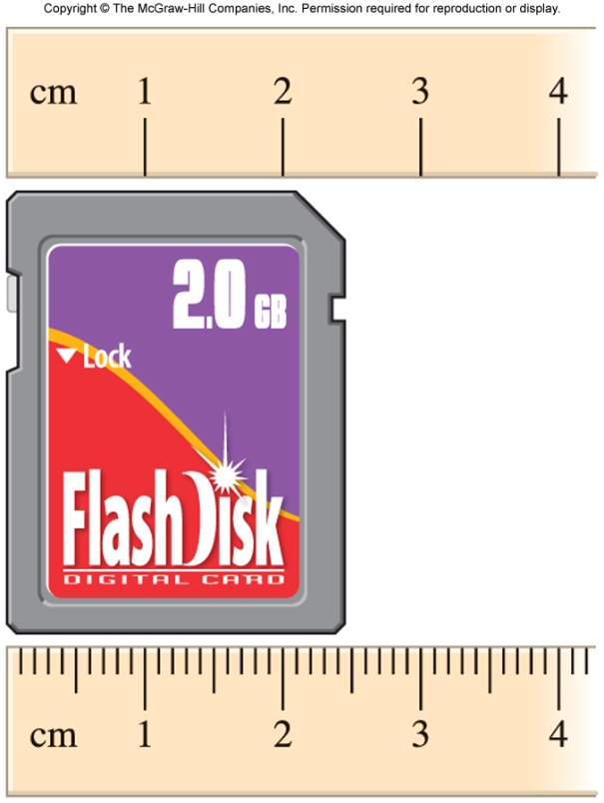
Chapter Summary: Key Points
1
The Scientific Method
States of Matter
Substances
Mixtures
Physical Properties
Chemical Properties
Extensive and Intensive Properties
SI Base Units
Mass
Temperature
Volume and Density
Significant Figures

